Slide 1

Camera Project - Kromico
Jon Scheckel, Team Lead & Optical Engineer
Nate Bolin, Mechatronics Engineer
Alba Samsami, Software/Firmware Engineer
Alex Smith, Mechanical Design & Fabrication Engineer
Jacob Cress - Advisor

Slide 2
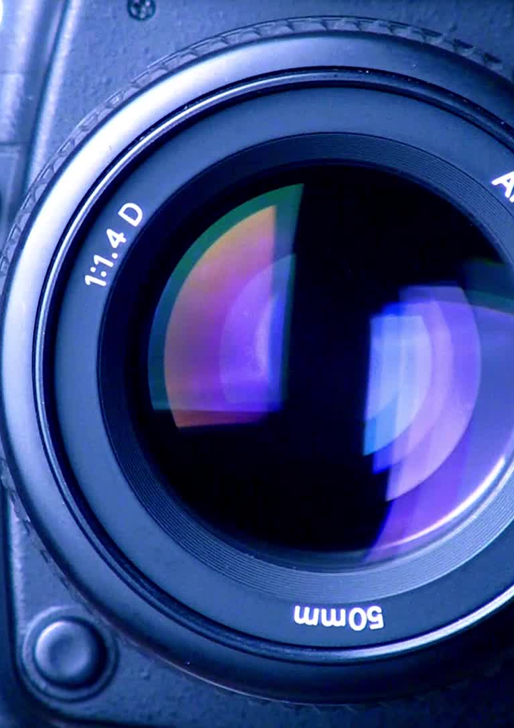
Background & Goals
Need high quality mono imaging with UV, IR, and narrowband filters
Current options are bulky or awkward
Deliver high-quality, multi-wavelength capture in the field without bulky equipment or tethered laptops
Integrate filter wheel around sensor to minimize size and optical path length
Execute end-to-end capture on device with focused UI and local SD storage
Create practical research instrument for astronomy, environmental monitoring, materials analysis, and forensics

Slide 3
Intellectual Merits
Research-grade low-light imaging on a low-cost Raspberry Pi using a monochrome sensor.
Integrated system: camera, light sensor, motorized filter wheel, display, and buttons in one standalone device.​
Fine-grained control of exposure (auto/manual ISO and shutter) for systematic imaging experiments.
Automated multi-filter capture via stepper-motor filter wheel for spectral/astrophotography-style imaging.
On-device menu UI and planned stacking/combination features for experimental imaging workflows without a PC.

Slide 4
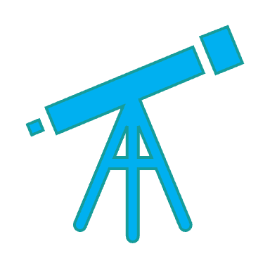
Broader impact
Expands access to low‑light scientific imaging using affordable, open hardware instead of expensive proprietary cameras.
Supports projects in astronomy, environmental monitoring, and microscopy by automating multi‑filter imaging with a motorized filter wheel.
Encourages open, reproducible research by sharing designs and code that others can adapt for their own sensing and vision applications.​​
Lowers the barrier for community labs, schools, and hobbyists to do quantitative imaging and data collection in settings that traditionally lack specialized equipment.

Slide 5
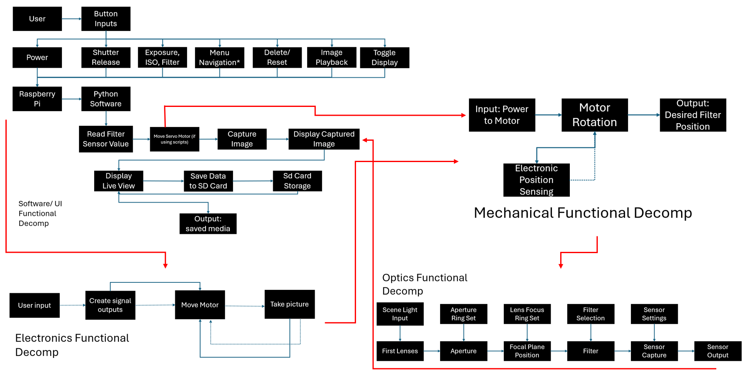
Design Specifications

Slide 6
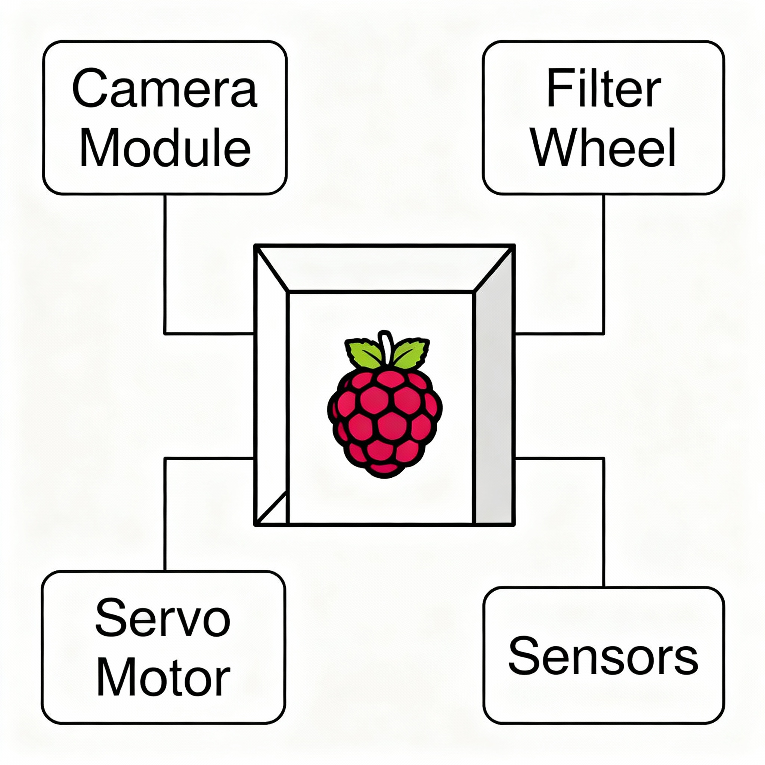
Technologies - Software
IMX290 monochrome camera on Raspberry Pi, optimized for low light.
Python Camera module using picamera2 with auto/manual ISO and shutter control.
Motorized filter wheel driven by a stepper motor with defined positions for each filter.​
light sensor to measure scene brightness for positioning.
On‑device display and buttons for menu navigation, mode selection, and capture control.
Modular Python structure (hardware/, core/, ui/, tests/) with a central main loop coordinating all components.

Slide 7
Milestones
Feb. 2026
Camera bring‑up and first images captured on Raspberry Pi
Feb. 2026
Camera module implemented with auto/manual exposure control
Feb. 2026
Motor driver and stepper motor tested for reliable stepping and homing
Feb.–Mar. 2026
Light sensor, display, and button inputs integrated into a single Python application
Mar. 2026
Filter wheel control plus multi‑filter capture workflow implemented and validated
May 2026
Full UI (menus, timers, capture modes) and image‑stacking features completed and demo‑ready
Mar. 2026
Filter Wheel Design & Body of the camera
Apr. 2026
Final Testing

Slide 8
Results
Planning & Proposal phase
Most of CAD designs for structure and filter wheel
Conceptual design for optics train and filter wheel
Camera operational on Pi with working Camera class (auto/manual exposure, test suite).
Designed 3D‑printed camera housing and filter‑wheel geometry for motor, filters, and sensor alignment.
Planned stepper‑motor step sequences, filter positions, and button layout for navigation/shutter.
Remaining tasks:
Finalize and print mechanical parts; assemble motor, sensors, and camera into enclosure.
Implement stepper control for repeatable filter‑wheel positioning.
Wire light sensor, display, and buttons; build on‑device menu UI for modes and settings.
Implement multi‑filter capture, image stacking, and end‑to‑end demo with processed results.

Slide 9
Challenges:
Camera instance conflicts: Multiple Picamera2 instances caused "device busy" errors; solved by implementing a singleton pattern in the Camera class to ensure only one instance exists.​
Overexposed images: Initial test captures produced white frames due to excessive ISO/shutter values; debugged by comparing direct picamera2 calls, tuned exposure parameters, and validated with auto-exposure baseline.
Mechanical alignment: Achieving precise filter-to-sensor alignment in housing required iterative design of mounting points and tolerances to prevent light leaks and maintain focus.
Motor positioning accuracy: Ensuring repeatable filter-wheel indexing demands reliable step counting and homing logic; designed a structured approach with defined step sequences and position tracking.
Real-time integration: Coordinating camera capture timing with motor movement to avoid vibration blur; planning wait periods after motor stop before triggering exposure for stable imaging.
Notes:
Feel free to change

Slide 10

Thank You

